Slide 1
Development of Comparison-based Phishing Email Classification system using Deep Learning Approach (BERT) Transformer
Authors:
Manthan Mehar 230370625001
Daxita Sonar 230370625003
Mayuri Pathak 230370625007
Ankur Jyoti Gogoi 230370625008
Guide:
Chanchal Patra
Centre for development of Advanced computing, CDAC Kolkata, India

Slide 2
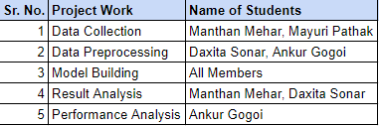
Project Work Distribution Chart

Slide 3
Content
Introduction
Internet Crime Reports
Objective
Workflow
Transformer
Dataset Description
Experimental Methodology
Results Analysis
Conclusion
Reference

Slide 4

Introduction
Phishing:
Phishing is a cybercrime in which a target or targets are contacted by email, telephone or text message by someone posing as a legitimate institution to lure individuals into providing sensitive data such as personally identifiable information, banking and credit card details, and passwords
Email phishing It is the most common type of phishing, and it has been in use since the 1990s.

Slide 5

Introduction
Types of Phishing:
Deceptive Phishing:Deceptive phishers use deceptive technology to pretend they are with a real company to inform the targets they are already experiencing a cyberattack.
Spear Phishing: This attack targets a specific individual or organization. The attacker tailors the message to the target's interests, role, or relationships to make it more convincing.
Whaling: Whaling is a common cyber attack that occurs when an attacker utilizes spear phishing methods to go after a large, high-profile target, such as c-suite executives.
Smishing (SMS Phishing): Attackers send fraudulent SMS messages to trick recipients into clicking on links, providing personal information, or taking other actions.
Vishing (Voice Phishing): In this attack, the attacker calls the victim impersonating a legitimate entity, often using scare tactics or urgency to get the victim to reveal sensitive information over the phone.

Slide 6
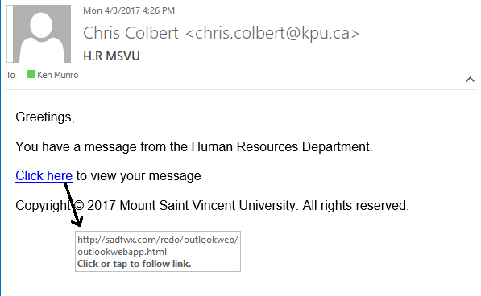
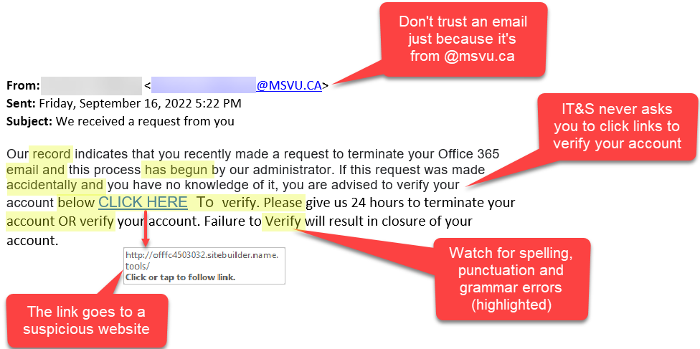
Introduction
Example of email phishing :

Slide 7
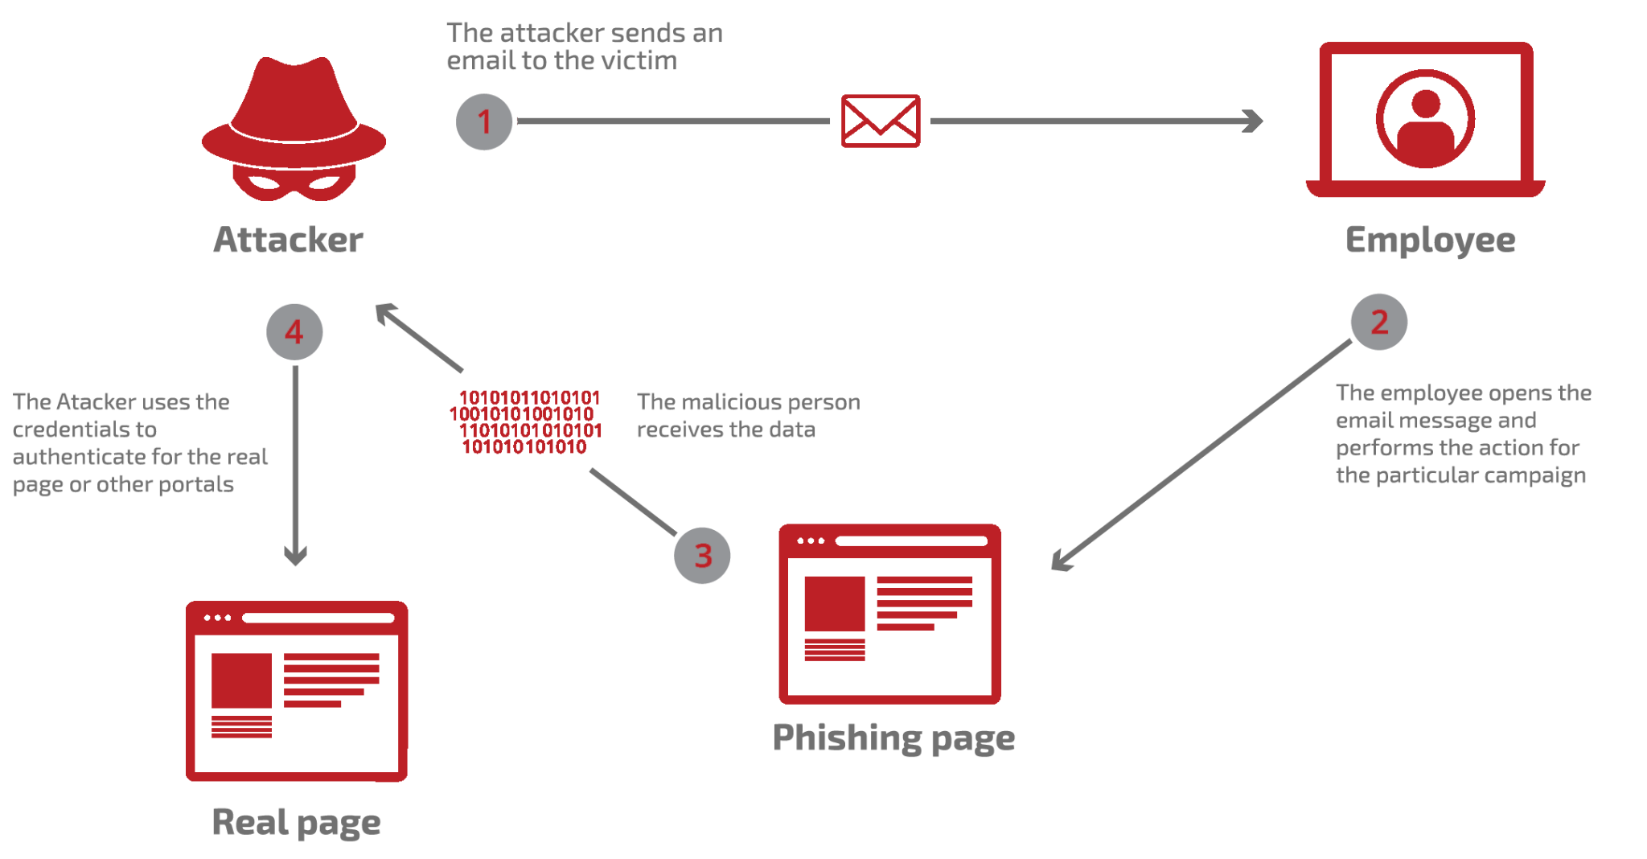
How phishing works?

Slide 8
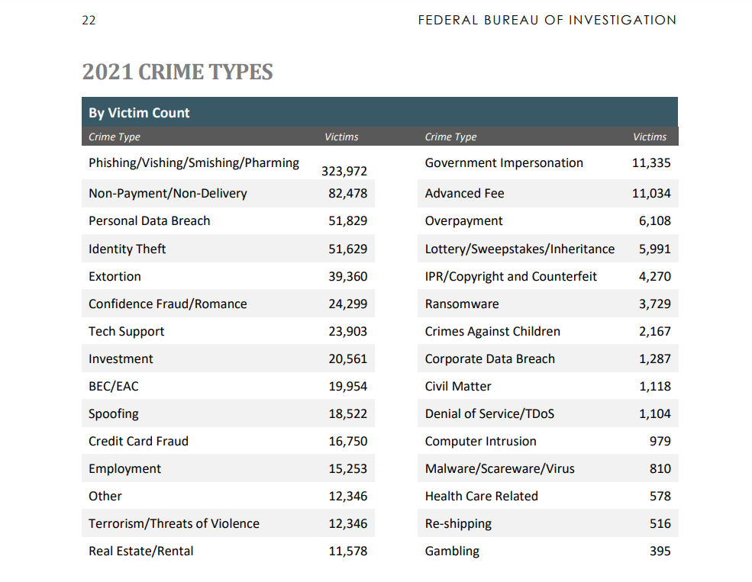
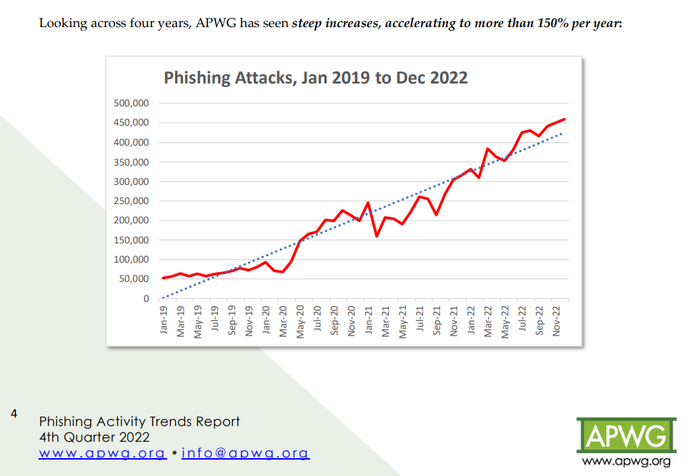
Internet Crime Reports

Slide 9

Objective
Development of Phishing email classification system using Transformer based pre-trained models which is a deep learning approach.
Given a new email, the system will be able to classify whether the input email is phishing or harmless

Slide 10
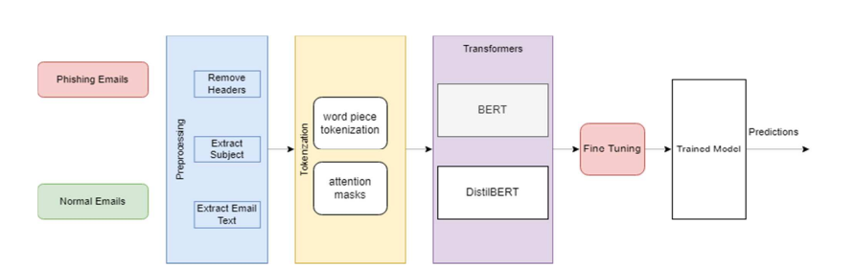
Workflow

Slide 11
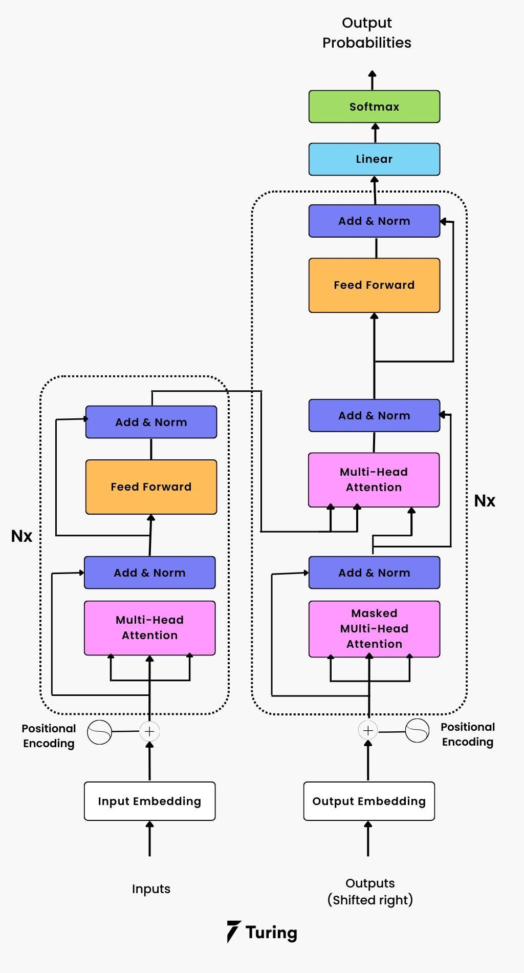
Transformer
What is Transformer?
Transformers are neural networks that learn context and understanding through sequential data analysis.
The Transformer models use a modern and evolving mathematical techniques set, generally known as attention or self-attention.
This set helps identify how distant data elements influence and depend on one another.

Slide 12

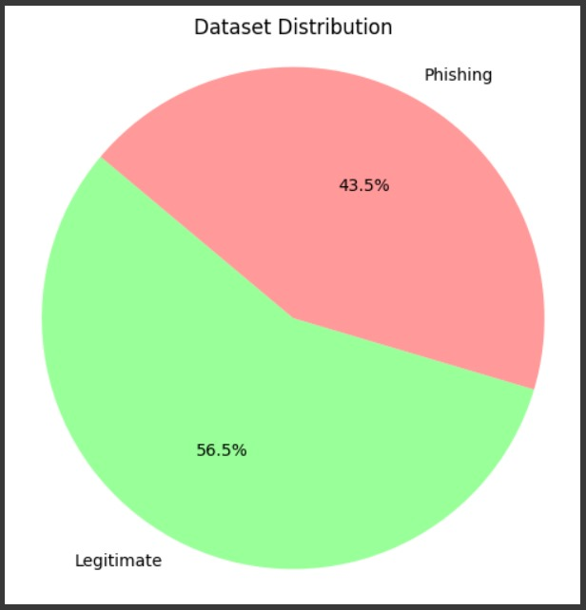

Dataset Descriptions
Total email text’s (11929)
Phishing [5187]
Legitimate [6742]

Slide 13
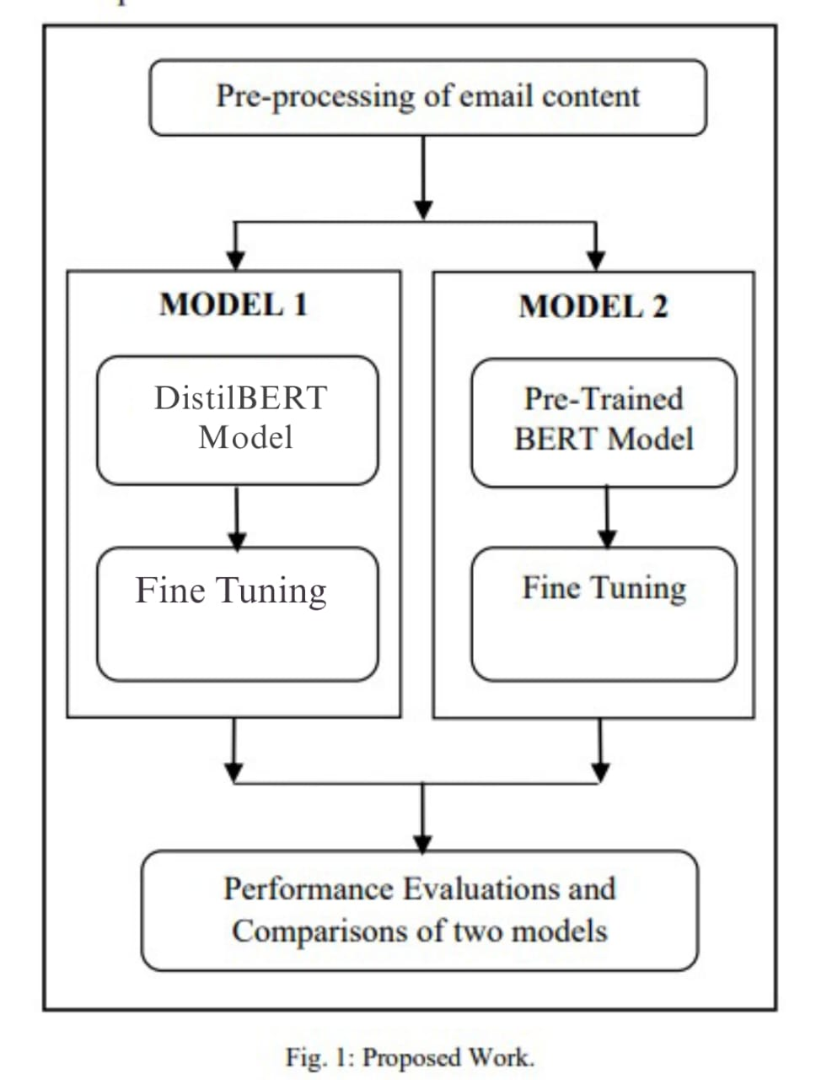
Experimental Methodology
A. Data Pre-processing:
1. Lowercasing and Tokenization
2. Removal of Non-Alphabetic Tokens
3. Lemmatization
4. Stop Words Removal
B. Model Selection and Construction:
Model 1 - BERT Model with Fine-Tuning
Model 2 - DistilBERT Model with Fine-Tuning

Slide 14
Experimental Methodology
C. Training and Evaluation
1. Model Training
Train Model 1 (BERT with Fine-Tuning) and Model 2 (Fine-Tuned DistilBERT).
Update model weights iteratively using training data.
2. Performance Evaluation
Assess models using key metrics:
Confusion Matrix: TP, TN, FP, FN classifications.
Accuracy: Overall correct prediction rate.
Precision: True positives among instances flagged as phishing.
Recall: Correct identification of actual phishing emails.
F1-Score: Harmonic mean of precision and recall.
D. Model Comparison and ROC Analysis
Model Comparison
Receiver Operating Characteristic (ROC) Analysis

Slide 15
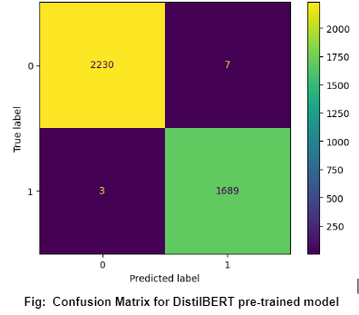
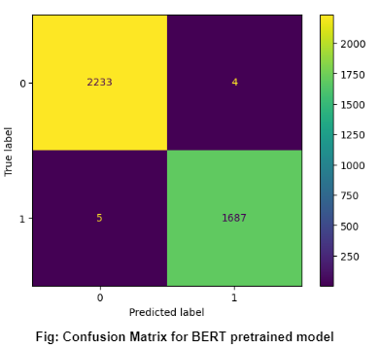
RESULT ANALYSIS
Confusion Matrix:

Slide 16
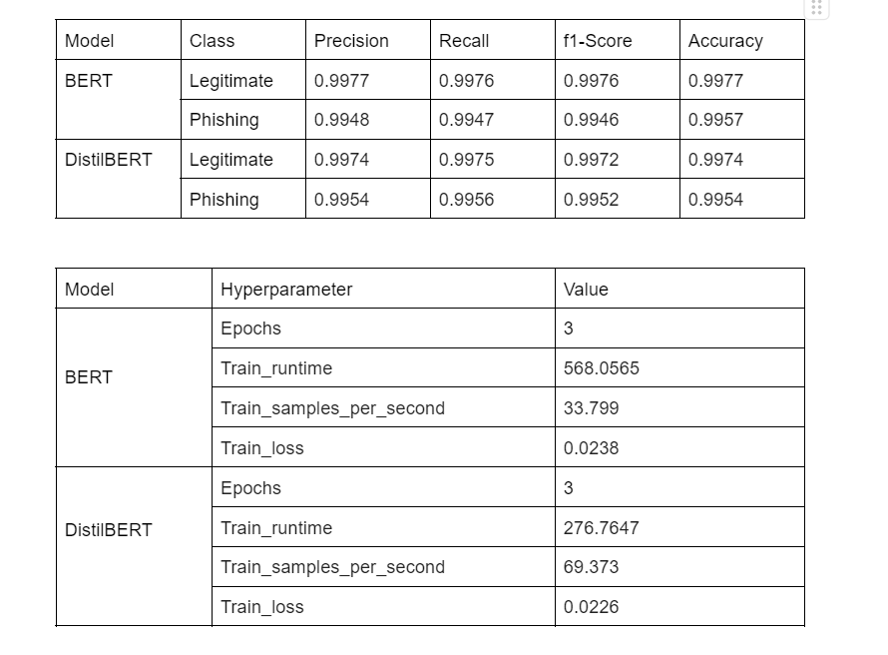
RESULT ANALYSIS
Performance Analysis:

Slide 17
Conclusion
Proposed a phishing email classification approach using pre-trained transformer models.
Utilized BERT and DistilBERT transformer models for the detection of phishing attacks.
Achieved high accuracy levels: 99% accuracy in phishing email detection.
Demonstrated minimal occurrences of false positives and false negatives, indicating robust performance.
Transformer models exhibited remarkable performance even in the presence of imbalanced datasets.
Successfully handled datasets with significantly higher instances of the negative class compared to the positive class.
Eliminated the need for complex feature extraction methods often used in traditional approaches.
Concluded that transformer-based models offer effective and accurate phishing email detection.

Slide 18
Reference
• Programming Language : Python (www.python.org)
• Tools Use : NLTK(www.nltk.org),scikit-learn (www.scikit-learn.org), TensorFlow (www.tensorflow.org) NumPy(www.numpy.org), Pandas( https://pandas.pydata.org ) transformers ( https://www.turing.com)
• Development: Google Colab(https://colab.research.google.com/)
• Relevant Paper:
A. N. Soni, “Spam email detection using advanced deep convolutional neural network algorithms” " Journal for innovative development in pharmaceutical and technical science, 2(5), 74–80, 2019.
M. Hiransha, N. A. Unnithan, R. Vinayakumar, and K. P. Soman, “Deep learning based phishing Email detection CEN-Deep Spam,” CEUR Workshop Proc., vol. 2124, no. Iwspa, pp. 16–20, 2018
T. Gangavarapu, C. D. Jaidhar, and B. Chanduka, Applicability of machine learning in spam and phishing email filtering: review and approaches, vol. 53, no. 7. Springer Netherlands, 2020

Slide 19


